Slide 1

Peltier - based Liquid Cooling System for Temperature Calibration

Slide 2
Objectives
The objective is to create a proof of concept for a Peltier-based liquid cooling system designed for temperature calibration.
Precise temperature control - The system will accurately control the temperature within a range of 10°C to 25°C, maintaining a resolution of 1°C with over & under temperature safety controls.
User-Friendly Interface: A simple user interface will allow users to set and store multiple temperature set points in the local EEPROM.
Cost Efficiency: The system will be built within the specified budget of Rs 4970, using the listed components and adhering to their typical prices.

Slide 3
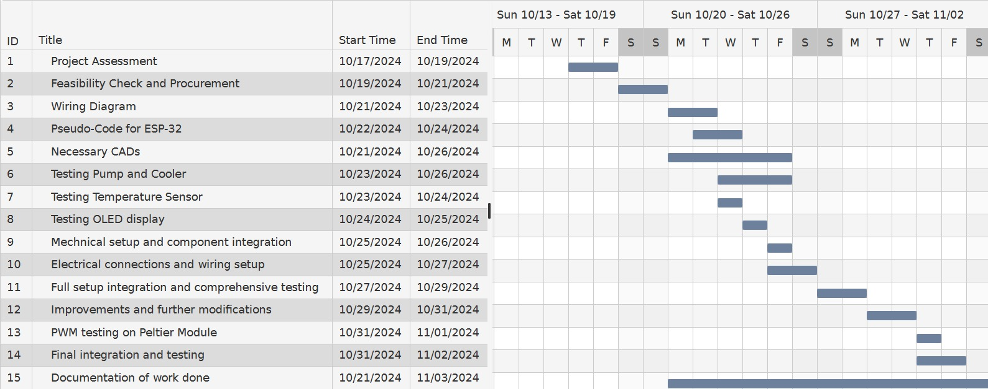
Timeline

Slide 4
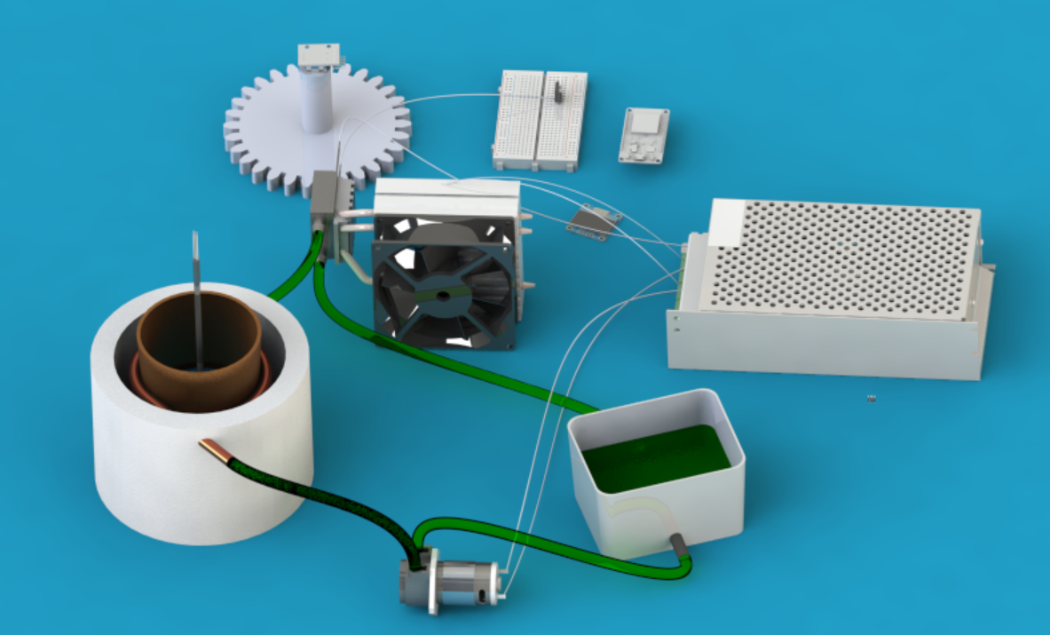
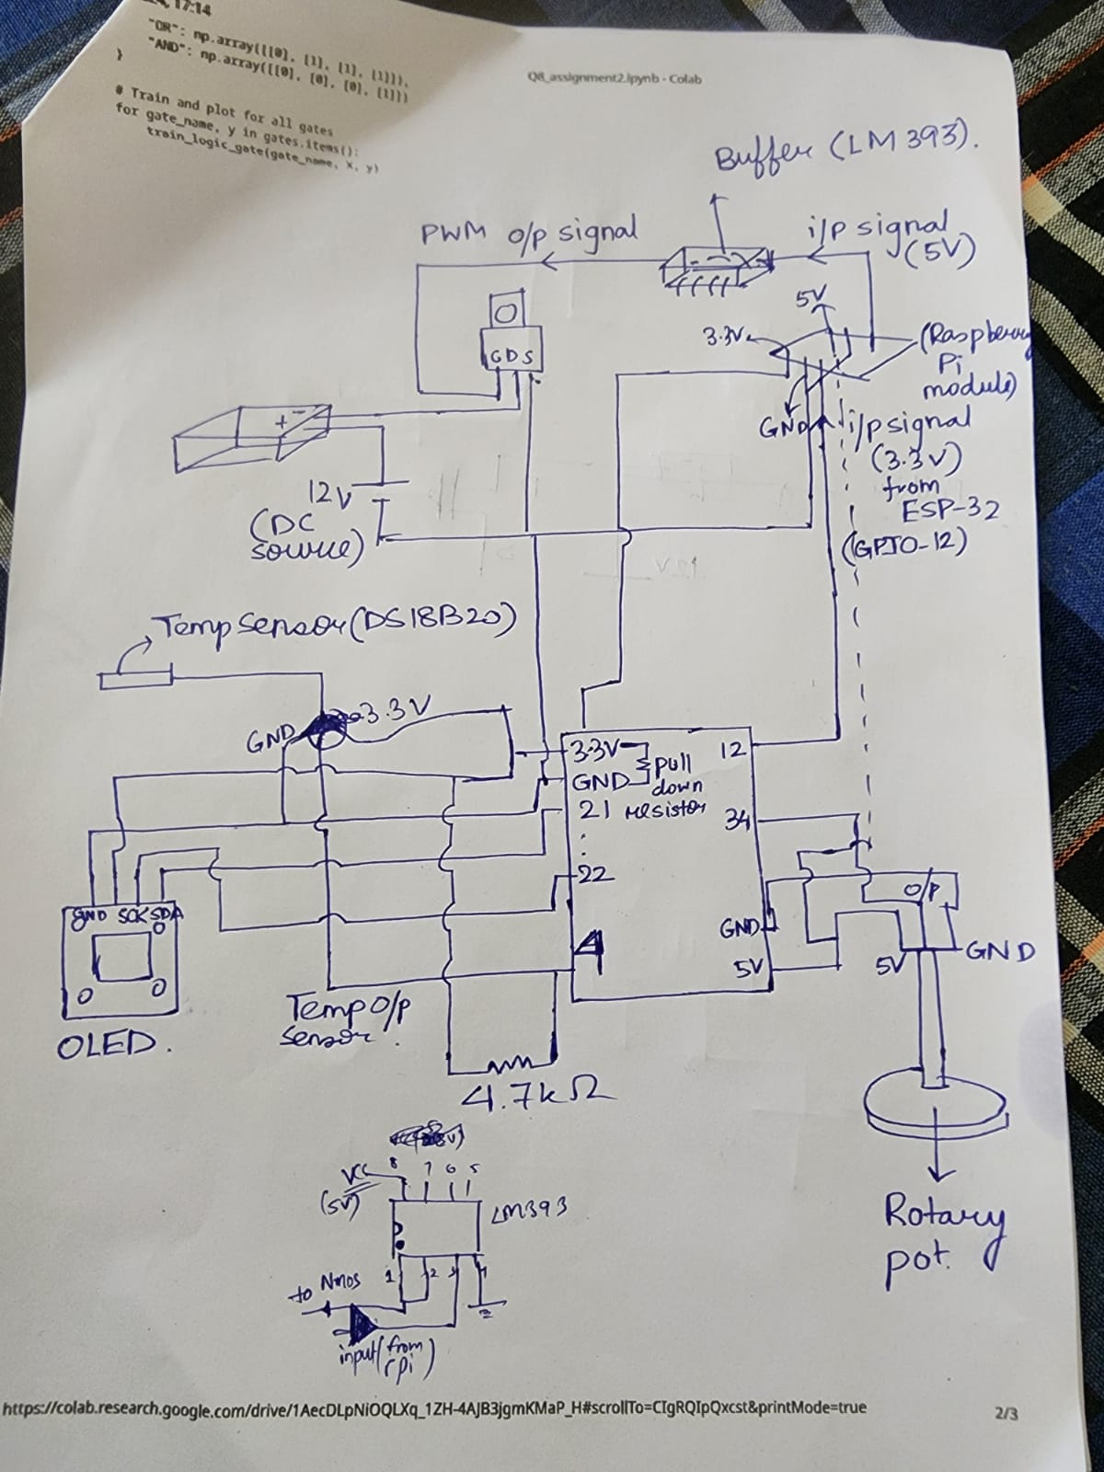
Circuit Diagram and Initial CAD

Slide 5
Modifications
A catch can was placed before the pump inlet to prevent air from entering the system.
Thermal paste was applied between the Peltier module and CPU cooler to improve heat conduction.
An NMOS transistor enabled voltage-controlled switching for PWM implementation.
The 3.3V control signal from the ESP32 was converted to a 5V signal using an 8-channel level shifter from the Raspberry Pi.
A buffer was added to protect the microcontroller from unwanted currents.
The TEC1-12706 Peltier module was selected over the TEC-12710 to save 4 amps, which could then power the CPU cooler and pump.
A heat sink was attached to the NMOS to dissipate excess heat from the power MOSFET.

Slide 6
Process
Comprehending the problem statement and procedure
Procuring necessary materials
Setting up the initial mechanical and electrical components
Testing the Peltier module with a CPU cooling fan
Testing the temperature sensor and OLED display
Setting a reference temperature using the rotary encoder output
Recording the time required for a 1°C change in water temperature
Implementing PWM control of the Peltier module using an NMOS transistor
Applying PID control to the Peltier module with ESP32

Slide 7
Results
Approximately 2⁰C change in temperature was achieved in 1 hr

Slide 8
Difficulties Faced
Delay in procurement of materials due to location and festive season
Not enough time for testing
Lack of guidance
Low room Temperature so difficulties in passive heating the water in case of overshoot
Power different components using the same power sourcen caused instabilities
Lag in serial communication protocols
Fine tuning of the PID controller

Slide 9
Scope of Improvement
Better heat dissipation using multiple fans/ cooling block
Optimum tuning of PID controller
Reducing the volume of coolant
Optocoupler instead of buffer

